Slide 1
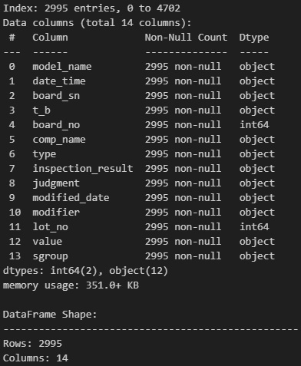
AOI Defect Analysis from September to December
Provided data rows | Number of duplicate rows removed | After removing duplicates | Missing data
4718 | 1723 | 2995 | 0
This slide presents the analysis of AOI defect data from September to December, with the following data processing steps:
Initial data rows (Provided data rows): The original dataset contained 4,718 rows.
Number of duplicate rows removed: Out of the total, 1,723 duplicate rows were removed.
Data after removing duplicates (After removing duplicates): After processing, 2,995 unique rows remained.
Missing data: There is no missing data in the dataset (Missing data = 0).

Slide 2
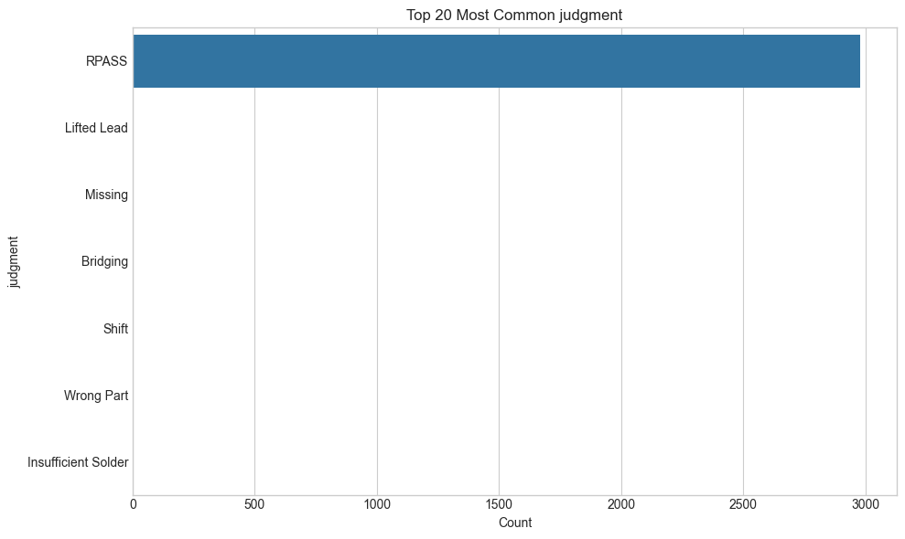
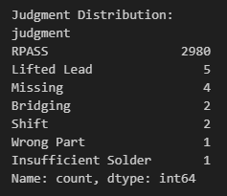
Overkill rate: 99%

Slide 3
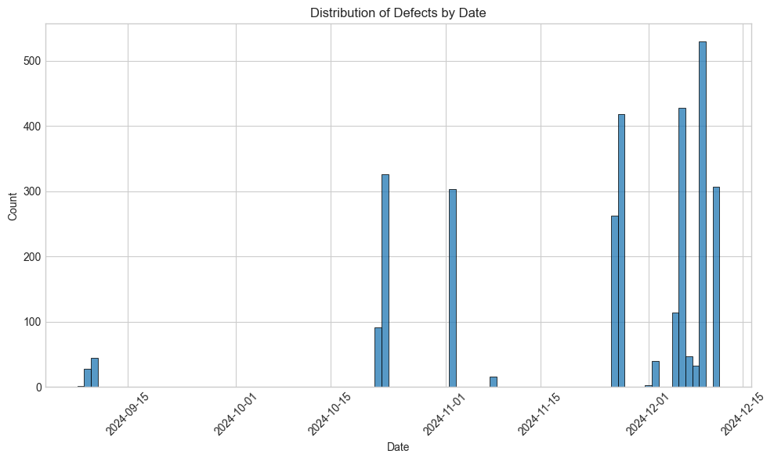
This graph shows the distribution of overkill by date.
The x-axis represents the dates, and the y-axis represents the count of overkill
Largest spike occurring around the 2024-12-10 date, reaching over 400 overkill.

Slide 4
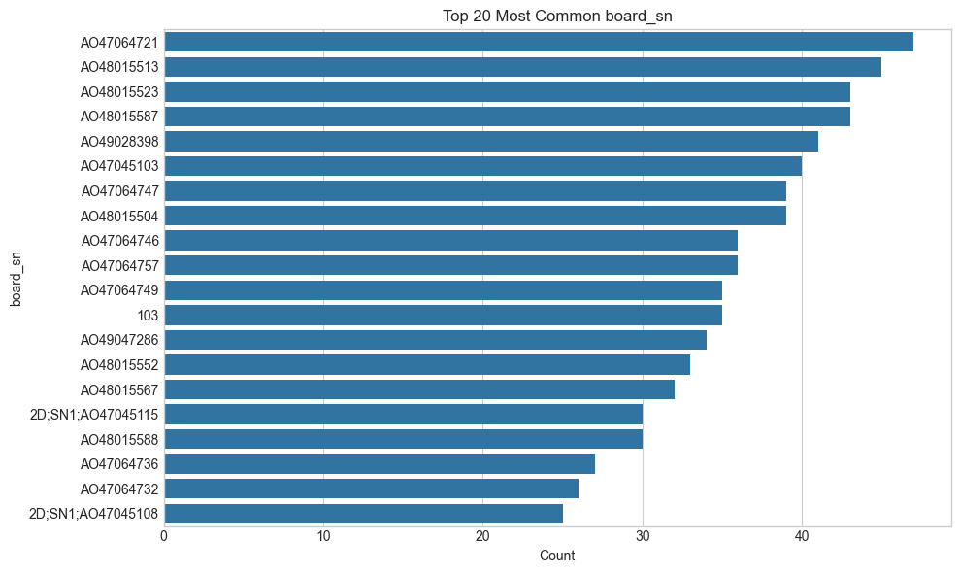
This graph shows the Top 20 Most Common “board_sn" (board serial numbers) and their respective counts.

Slide 5
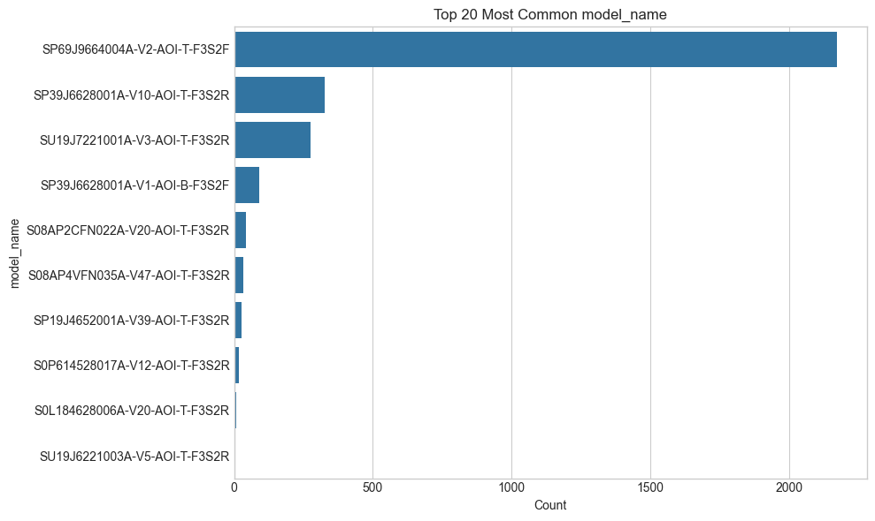
The graph shows the top 20 most common model_name values, with the corresponding counts for each model name.
The model name with the highest count is "SP69J9664004A-V2-AOI-T-F3S2F", which has a count of over 1800.
The "SP69J9664004A-V2-AOI-T-F3S2F" model appears to have a much higher number of overkill compared to the other top models shown in the graph. This suggests that this particular model is experiencing more overkill than the others during the time period covered.

Slide 6
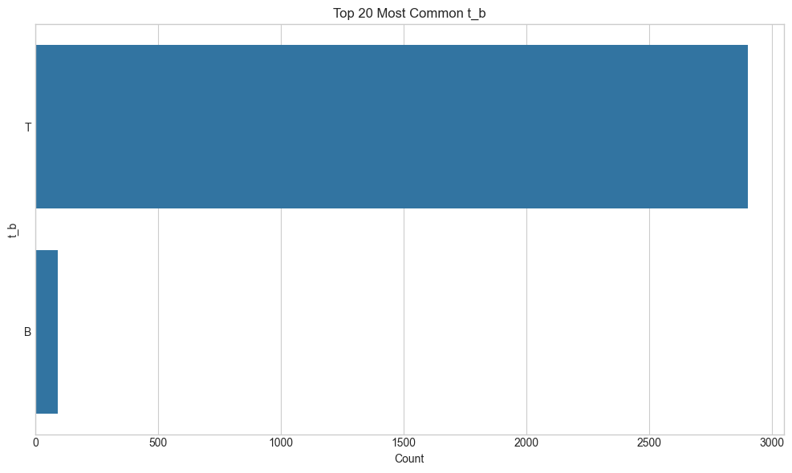
This chart displays the count of top and bottom sides of the total overkill products in the dataset.

Slide 7
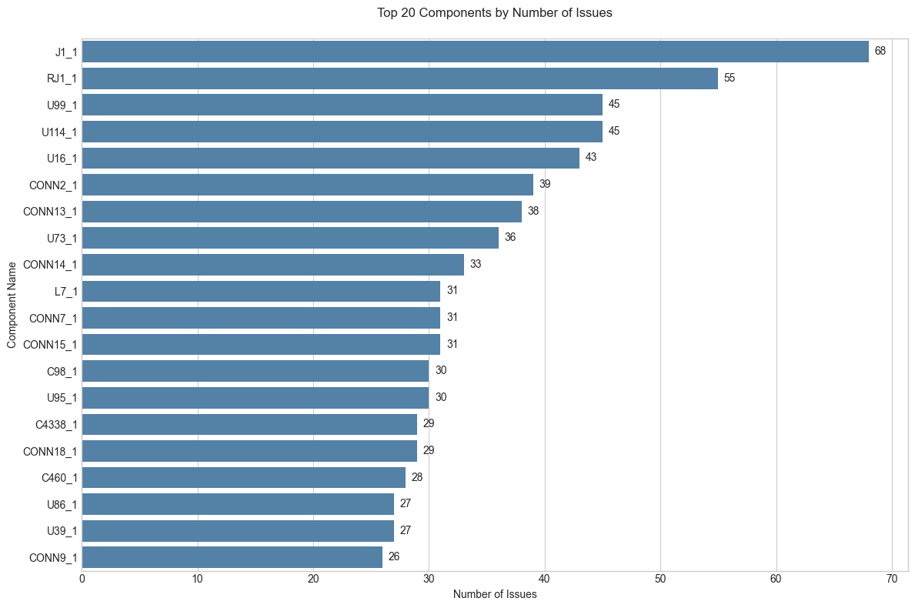

Slide 8
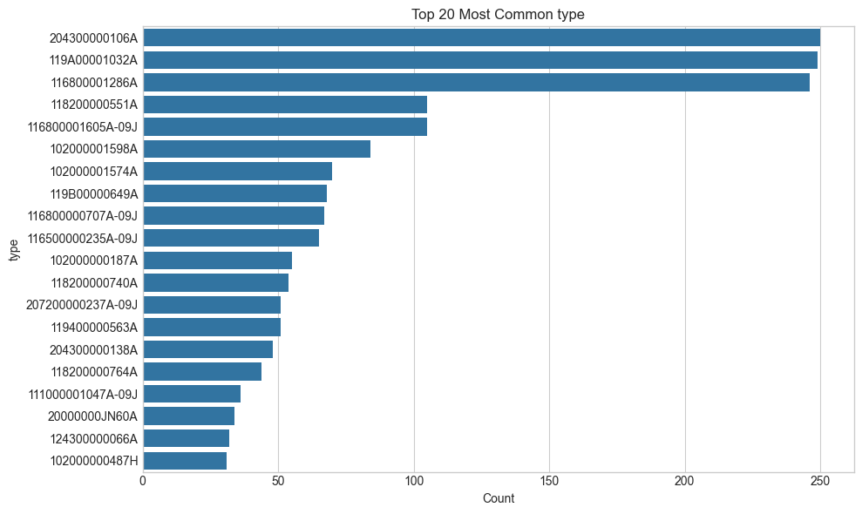

Both “type” and “sgroup” refer to the codes of components where overkill occurs. As shown in the chart, the three codes with the highest number of overkill incidents are 204300000106A, 119A00001021A, and 116800001286A.

Slide 9
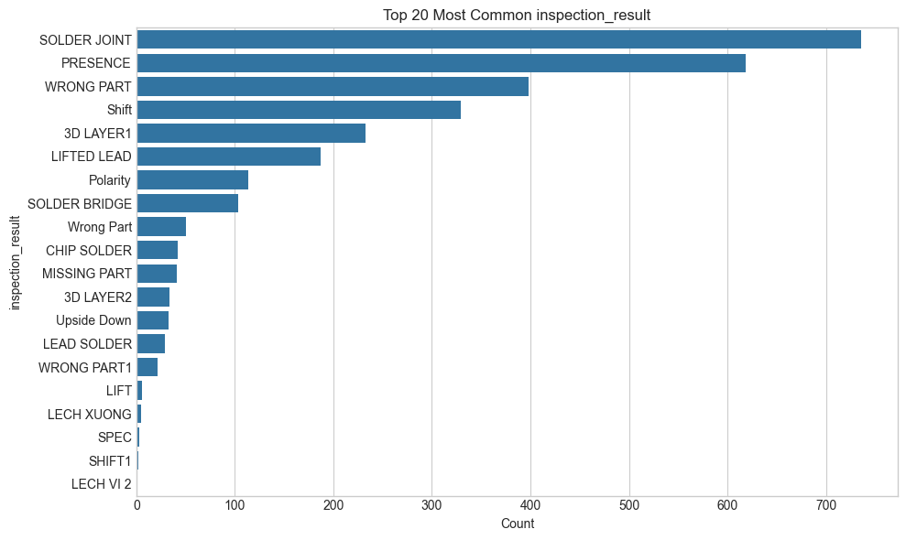
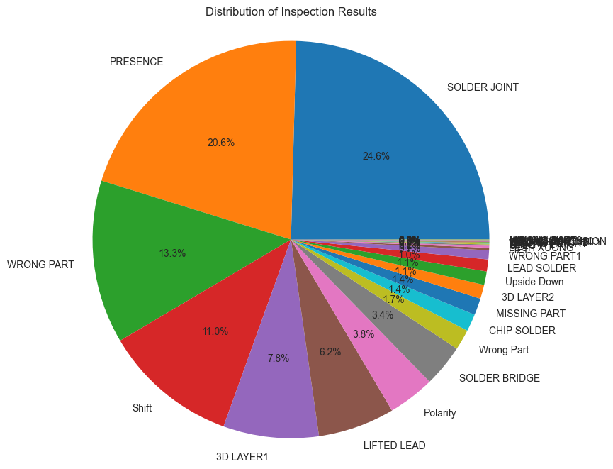

Slide 10
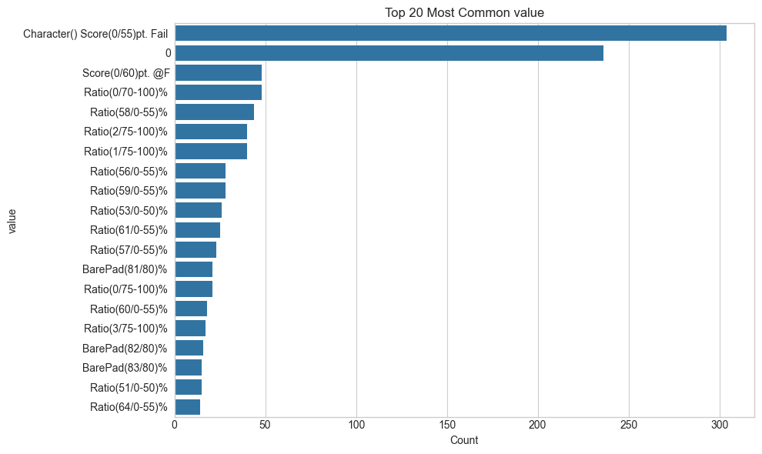

Slide 11
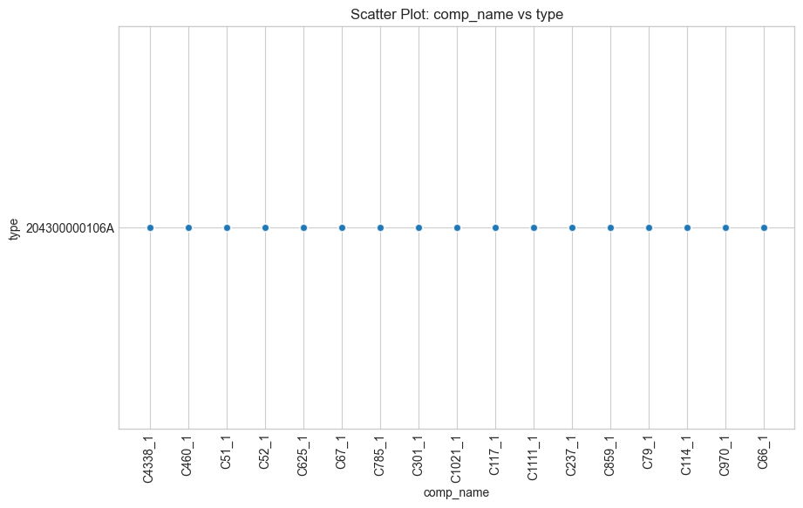

Slide 12
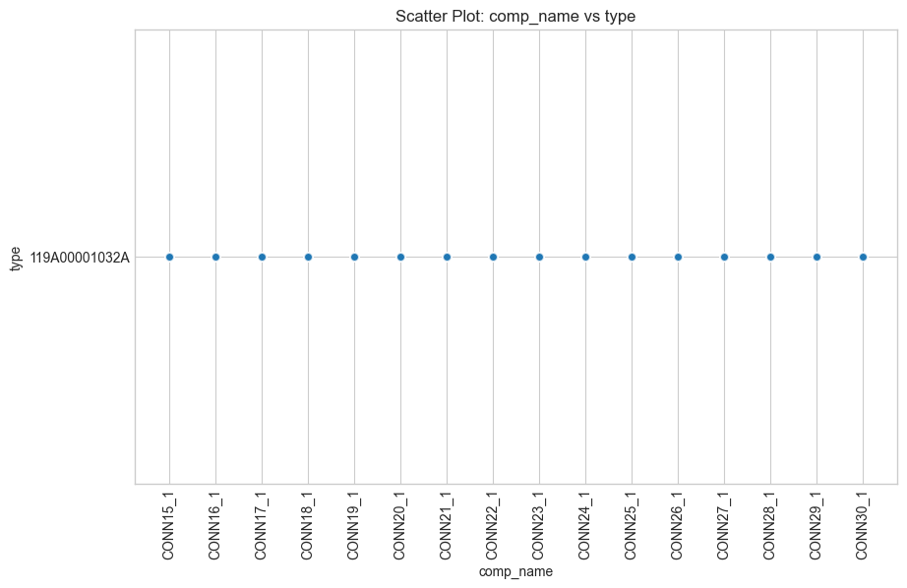

Slide 13
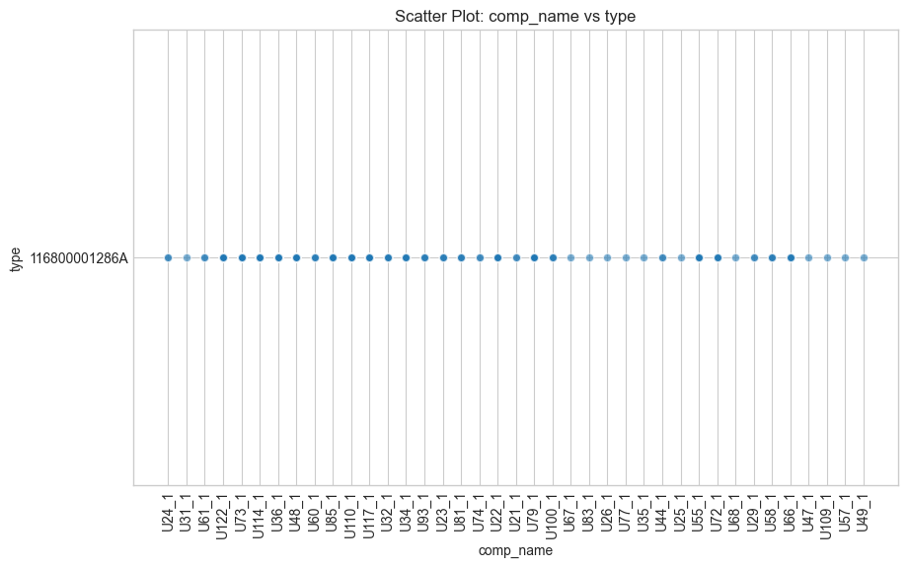

Slide 14
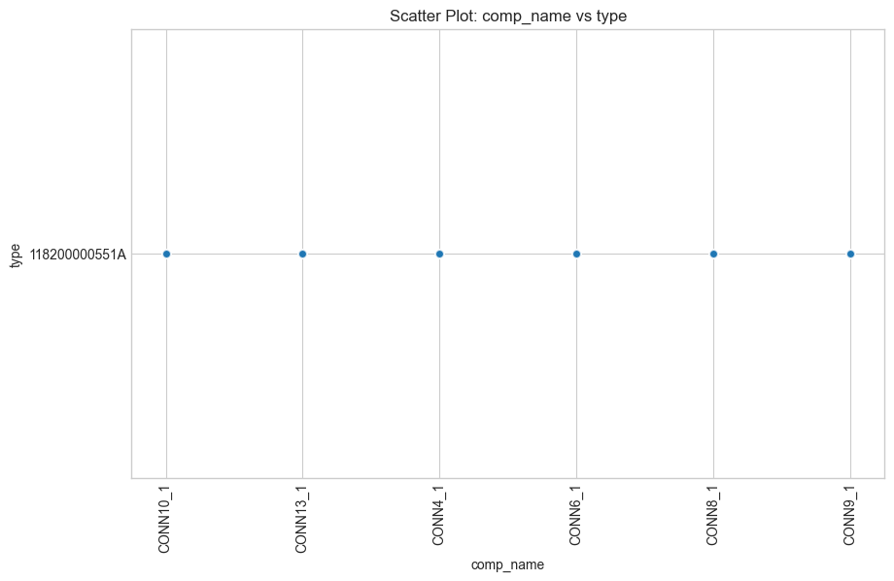

Slide 15
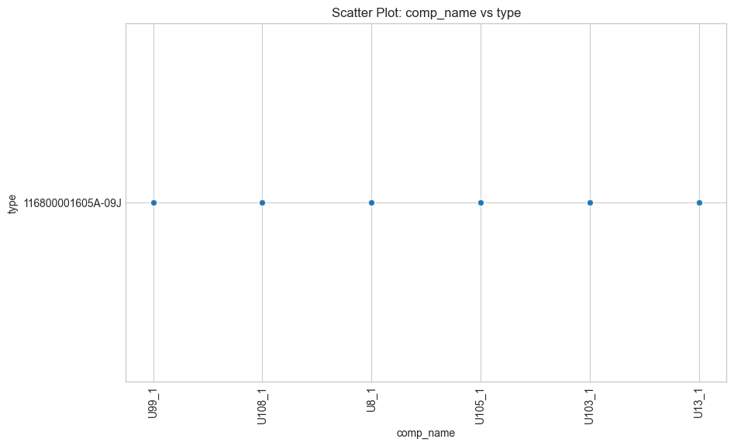

Slide 16
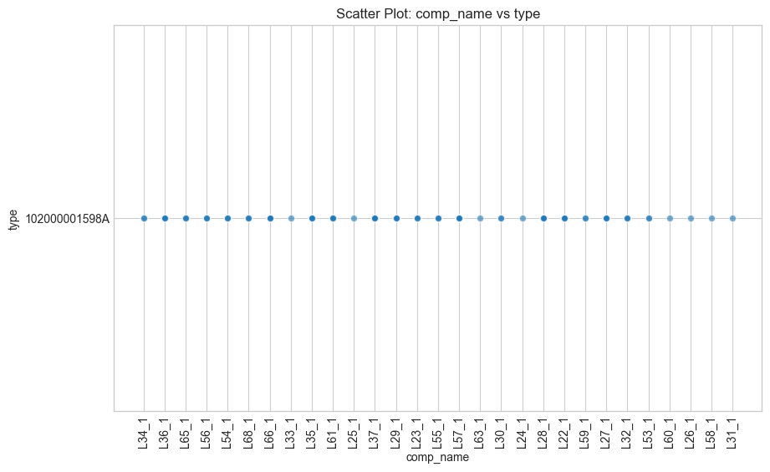

Slide 17
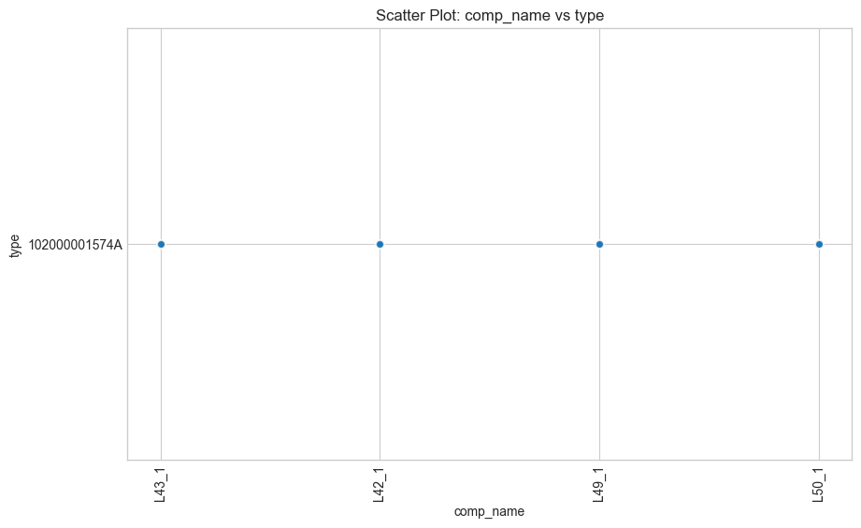

Slide 18
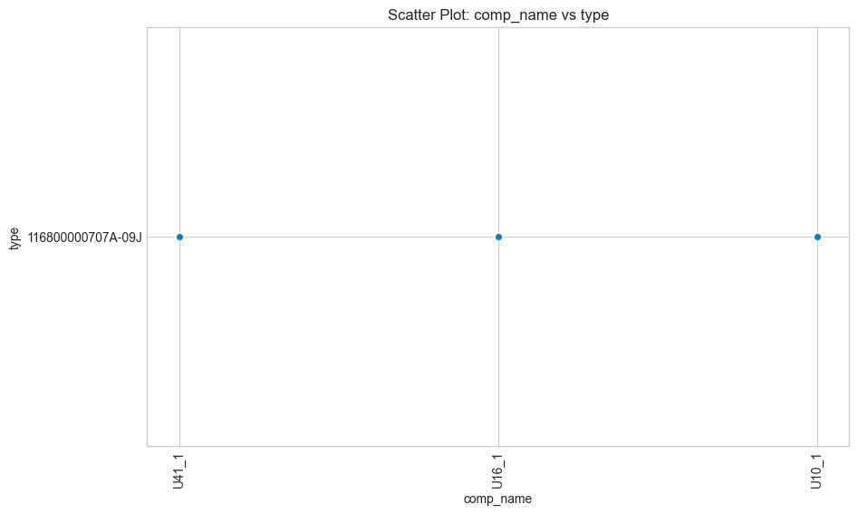

Slide 19
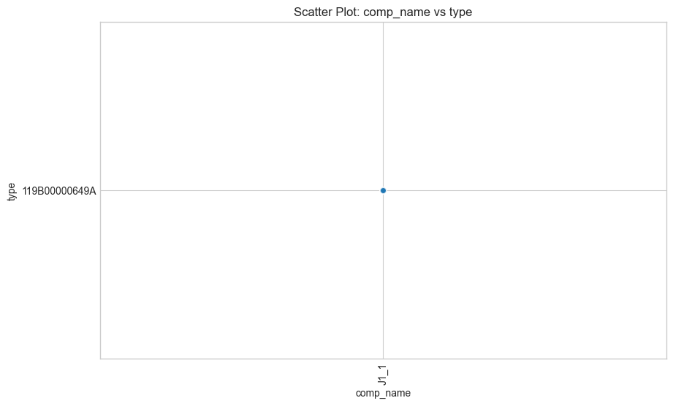

Slide 20
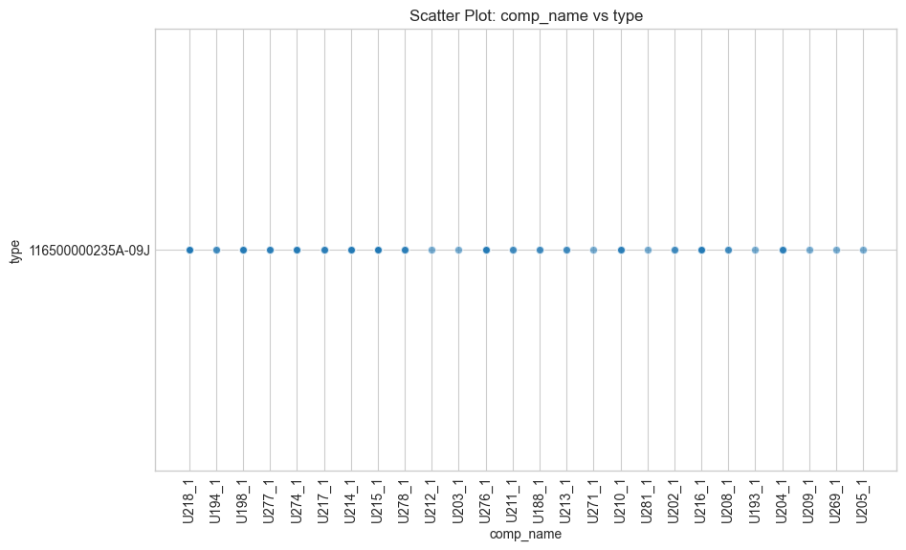

Slide 21
